Slide 1

Department Resource Booking System
INSTRUCTOR: DR. ZUNNURAIN HUSSAIN, Sir UMAIR MAKHDOOM
TEAM: TURAB HASHMI | LAIBA AHMAD
BSSE23002 | BSSE23085

Slide 2

The Problem: Manual Booking Headaches
Double Bookings
Scheduling Conflicts
Manual systems lead to resources being booked by multiple parties simultaneously.
Lack of real-time visibility creates clashes and inefficiencies.
Administrative Delays
Students and staff face long queues and reduced productivity.

Slide 3

Our Solution: A Cloud-Based Booking System
We developed a Departmental Resource Booking System to eliminate manual booking problems like double booking and lack of real-time visibility.
Full-Stack Application
AWS Hosted
React (frontend) and Node.js (backend).
Deployed on AWS EC2 for robust performance.
DynamoDB Storage
Secure and fast data retrieval with Amazon DynamoDB.

Slide 4
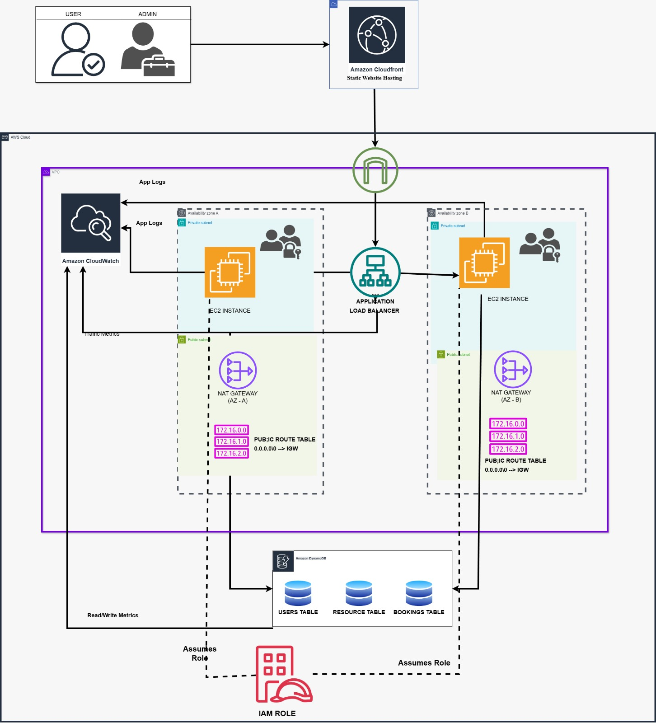
System Architecture Overview
Our decoupled architecture ensures seamless interaction between the frontend, backend, and database components.

Slide 5

Technical Implementation: Decoupled & Secure
The application uses a Decoupled Architecture, with frontend and backend running as separate processes.
Deployed in an AWS VPC with Public Subnet and Internet Gateway for accessibility.
Security is handled by AWS Security Groups, allowing only essential ports: Port 22 (SSH), Port 3000 (React), and Port 5000 (Node.js API).

Slide 6

Key Features: Empowering Users
Real-time Availability
Automated Booking
Instantly check resource availability for labs, rooms, and equipment.
Secure login and validated booking requests handled automatically.
Admin Dashboard
24/7 Cloud Access
Admins manage pending bookings and update resource status efficiently.
Deployed on AWS for anytime, anywhere accessibility.

Slide 7

Frontend: React.js
Our user-friendly interface is built with React.js, providing a dynamic and responsive experience for all users.
React's component-based architecture ensures modularity and easy maintenance.

Slide 8

Backend: Node.js
The robust backend, powered by Node.js, handles all booking logic, validation, and database interactions.
Node.js's asynchronous nature allows for efficient handling of multiple requests, ensuring a smooth user experience.

Slide 9

Database: Amazon DynamoDB
Amazon DynamoDB provides a fast, flexible, and scalable NoSQL database solution for our system.
Its serverless architecture ensures high availability and performance, crucial for real-time booking data.

Slide 10



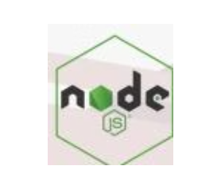


Tools & Technologies
A suite of powerful tools and platforms were utilized to develop and deploy our Department Resource Booking System.

